Slide 1
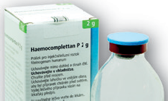
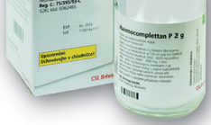
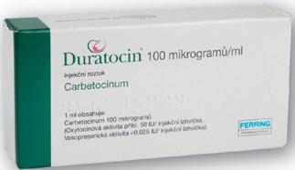
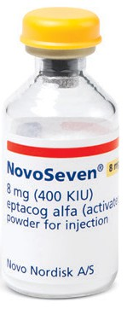
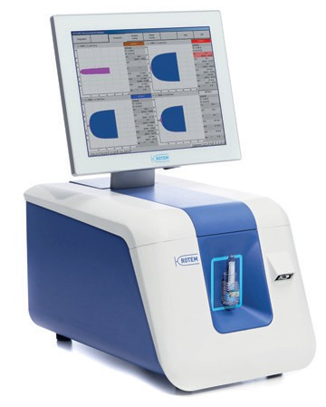
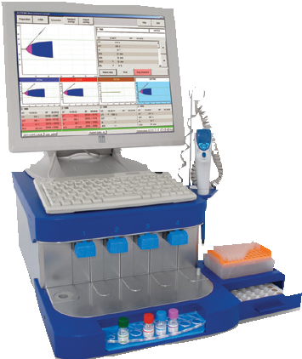
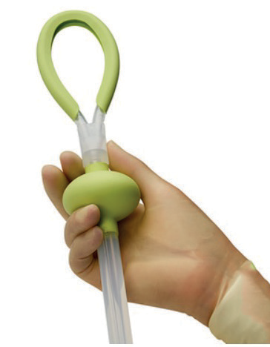
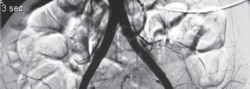
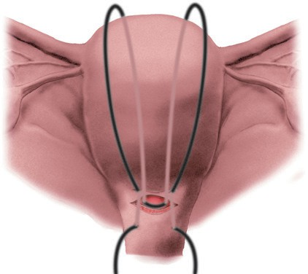
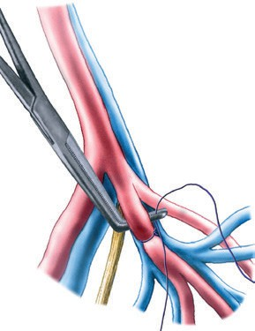
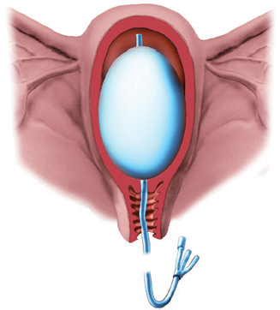
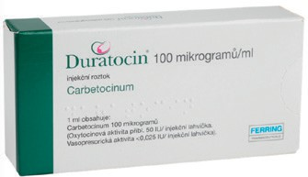
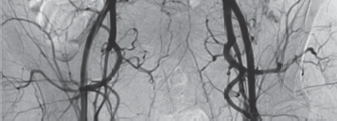
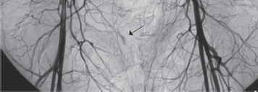
Peripartum haemorrhage - Obstetrician's procedures
Diagnosis and localisation of the bleeding source
Estimated blood loss:
less severe: 500 - 1000 ml
severe: over 1000 ml
peripartum life-threatening bleeding: rapidly increasing blood loss, clinically estimated above 1500 ml, or any blood loss associated with the development of clinical and/or laboratory signs of shock/tissue hypoperfusion
Organisation of provided care according to estimated blood loss:
less severe blood loss
= always an obstetrician is called
severe blood loss
= always an anaesthetist is called as well
peripartum life-threatening bleeding
= always a multidisciplinary crisis team is activated
Identification of the bleeding source:
palpation/bimanual examination
speculum examination
ultrasound examination
Further procedures:
assessment and securing of vital functions
initiation of monitoring of vital functions
initiation of oxygen therapy
securing/checking vascular access
initiation of fluid replacement/fluid resuscitation
catheterisation of the bladder
consideration of the following procedures:
uterine massage
bimanual uterine compression
external aortic compression
Recommended initial laboratory tests:
complete blood count
coagulation tests (aPTT, PT, antithrombin)
fibrinogen level
pretransfusion testing (blood group, screening for irregular erythrocyte antibodies, compatibility test)
consider viscoelastic testing
Initial transfusion product requirements:
plasma (in the initial phase, ensuring the availability of at least 4 transfusion units)
erythrocytes (in the initial phase, ensuring the availability of at least 4 transfusion units)
[1]Ensuring internal environment stability:[2]
acid-base balance
temperature
ionized calcium level (Ca²⁺⁺)
Pařízek A., Černý V., Blatný J., Kvasnička T., Salaj P.
Elimination of the cause of bleeding
Obstetrics Forum.cz
Uterine Hypotonia/Atony
Step 1
Step 2
Step 3
Hysterectomy in a woman of reproductive age is a serious act that significantly affects her future life. We approach hysterectomy with great caution and on an individual basis.
Performing a hysterectomy
Indications for hysterectomy:
continued uterine bleeding despite the failure of previous steps and exhaustion of all available options (pharmacological and surgical)
placenta accreta spectrum, when the clinical findings do not allow for a conservative surgical approach
devastating uterine injury
uterus as the presumed source of sepsis
Surgical interventions are always performed under intravenous antibiotic coverage.
uterotonics
oxytocin or carbetocin
methylergometrine (if maternal hypertension is not present)
catheterisation of the bladder
uterine massage
digital or instrumental uterine cavity revision
prostaglandins
tranexamic acid
removal of clots
from the vagina and uterine cavity
uterotonics
- prostaglandins
pressure, vacuum, and haemostatic
intrauterine devices
fibrinogen
timing of rFVIIa administration according to the Relevant Scenario
Selective Catheter Embolisation
Uterine Arteries (if Interventional Radiology is Available)
surgical intervention
(stepwise uterine devacularisation)
stepwise ligation of uterine and ovarian arteries
uterine compression sutures
ligation of internal iliac arteries
If unsuccessful - Step 2
If unsuccessful - Step 3
If unsuccessful - Step 4
Retained placenta
Step 1
oxytocin, preferably carbetocin
bladder catheterisation
[1]If unsuccessful[2]
Step 2
1. manual removal under prophylactic antibiotic coverage
[1]Medications and their dosages[2]
Retained placental fragments
Step 1
oxytocin, preferably carbetocin
bladder catheterisation
gentle revision of the uterine cavity
[1]If unsuccessful[2]
Step 2
1. proceed as
in uterine atony
Oxytocin (Oxytocin®)
Dinoprostum (Enzaprost F®)
Fibrinogen
Initiation of treatment: 5 IU oxytocin i.v. (administered over 1 minute) and 5 - 15 IU/hour in an infusion solution until bleeding stops.
5 mg in 500 ml infusion solution, administration rate: 5 ml/min (= 300 ml/h), do not exceed a dose of 20 mg.
if no response, administer carboprost
Ensuring internal environment stability:
Administration of fibrinogen is recommended
in PPH
when its concentration drops below 2 g/L i.v.
Initial dose:
In PPH, a minimum of 4 g i.v. is recommended.
Carbetocin (Duratocin®)
Uterine rupture/dehiscence
Step 1
1. Laparotomy and primary uterine management
If unsuccessful
Step 2
1. Hysterectomy if primary management fails
Replacement of oxytocin infusion: 100 µg i.v. (administration time: 1 minute)
Carboprost (Prostin 15M®)
Initiation of treatment:
0.25 mg i.m. or intramyometrially as needed then: every 15 minutes 0.25 mg i.m., do not exceed a total dose of 2 mg (eight doses of 0.25 mg)
Uterine inversion
Step 1
1. Manual uterine repositioning
(under general anaesthesia or wait for uterotonic effects to wear off)
If unsuccessful
Step 2
1. Laparotomy
- Uterine repositioning
Recombinant factor VIIa
(NovoSeven®)
Methylergometrine
Misoprostol (Cytotec®)
Administration of rFVIIa is indicated for the treatment of severe postpartum haemorrhage when uterotonics are insufficient to achieve haemostasis—according to the relevant protocol.
Initial dose: 90 µg/kg
Initiation of treatment: 0.2 mg i.m. or slow i.v. 400–600 µg sublingually, rectally, vaginally, then: repeat administration of 0.2 mg after 15 minutes orally. If needed, may be administered after 15 min,
^{methylergometrine i.m.} or: 0.2 mg i.m., ^{repeat, maximum dose 800 µg.}
or slow i.v. every 4 hours, do not exceed a total
dose of 1 mg (five doses of 0.2 mg)
DIC:
PLT, APTT, PT,
fibrinogen, D-dimers, antithrombin
Step 1
DIC diagnosis
Identifying the cause
Substitution of coagulation factors and inhibitors (plasma, antithrombin, fibrinogen)
Step 2
1. If stabilised, consider anticoagulant prophylaxis; if the condition persists, consult a haematologist.
Tranexamic acid (Exacyl®)
© Porodnice.cz 2025
Prostaglandins F_{2α}
Initial dose: In PPH, 1 g i.v. over 10 minutes is recommended, with additional doses based on the patient's clinical status.
Total dose should not exceed 2 g/day.
If bleeding continues even after administration of oxytocin, carbetocin, or ergometrine:
Primary haematological disorder
Step 1
1. Contact a haematologist for additional normalisation of
coagulation factor levels
Uterotonics
Pressure, vacuum, and haemostatic intrauterine devices
Interventional radiology
Surgical interventions
ABBREVIATIONS USED:
PPH – peripartum life-threatening haemorrhage
Thromboelastometry provides rapid information
about the acute state of haemostasis, allowing differentiation of bleeding causes and targeted treatment.
aPTT – activated partial thromboplastin time
PT – prothrombin time
ATB
T.U.
TP
Antibiotics
Transfusion unit
Transfusion product
rFVIIa – recombinant activated factor VII
Oxytocin, carbetocin, prostaglandins
Bakri balloon®
CELOX PPH®
JADA®
Selective catheter embolisation of uterine arteries
B-Lynch uterine suture
Ligation
of internal iliac arteries
PPH Leaflet A3.indd 2-3

Slide 2
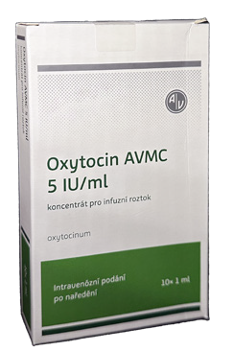
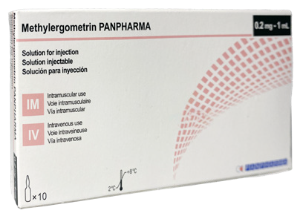
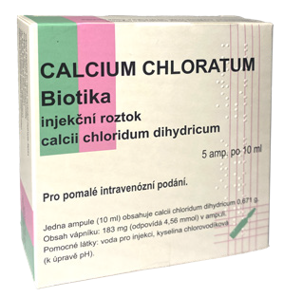
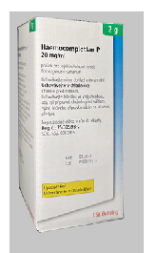
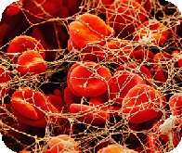
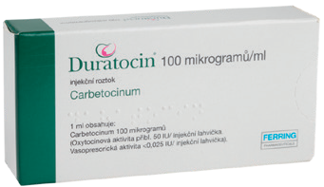
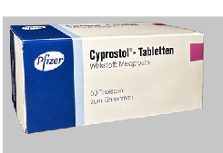
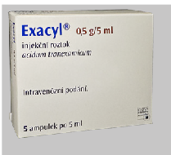
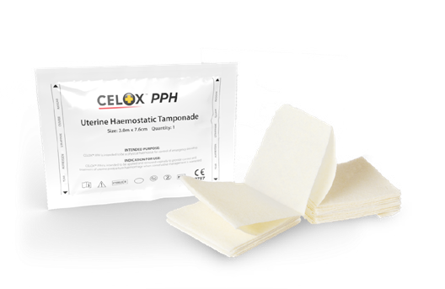
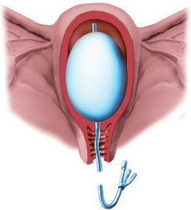
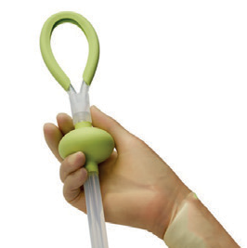
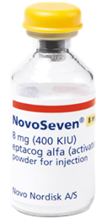
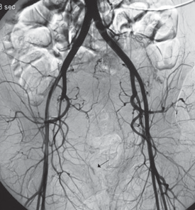
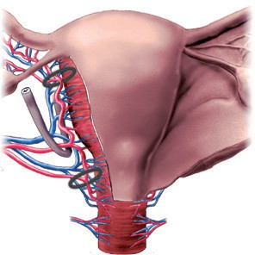
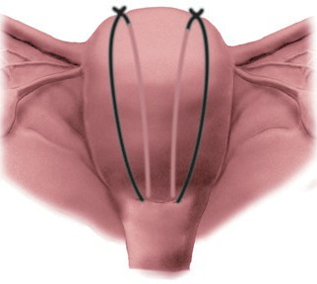
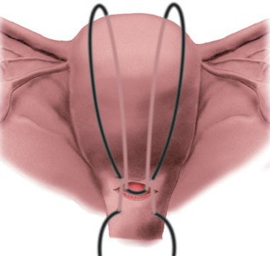
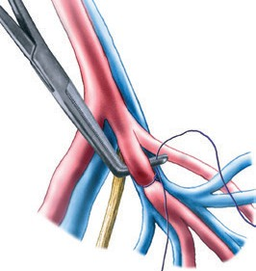
Treatment management
Postpartum haemorrhage (PPH)
Pařízek A., Černý V., Blatný J., Salaj P, Kvasnička T.
Postpartum haemorrhage (PPH)
Pařízek A., Černý V., Blatný J., Salaj P, Kvasnička T.
Prophylaxis with uterotonics
Identification of PPH
Bleeding during human childbirth
Vaginal delivery:
Caesarean section:
Determining the cause (4T)
Tone
Trauma
Tissue
Thrombin
Mechanism of haemostasis = combination of two factors
Mechanical Haemostasis
Retraction of the myometrium – uterotonic agent
Intrauterine pressure and vacuum devices
Coagulation
Tranexamic acid,
Fibrinogen,rFVIIa
Uterine massage
Uterotonics
Tranexamic acid Fibrinogen
Bakri balloon®, Celox PPH®,
JADA®, NovoSeven®
Peripartum Bleeding – Definition (Czech Republic)
Physiological blood loss: < 500 ml
Mild blood loss: 500 – 1,000 ml
Severe blood loss: > 1,000 ml
Peripartum life-threatening bleeding: > 1,500 ml
(With clinical and/or laboratory signs of tissue hypoperfusion)
Scenario 1
Following vaginal delivery
In PPH following vaginal delivery, consider administration of rFVIIa after using first-line non-invasive and invasive measures
(uterotonics, TXA, intravenous fluids/blood/blood products and fibrinogen, treatment of birth injuries, uterine cavity revision, uterine tamponade),
if the patient is still bleeding, before laparotomy or uterine artery embolisation.
Scenario 2
During caesarean section
In PPH during caesarean section, consider using rFVIIa after failure of first-line surgical measures
(compressive sutures of the uterus, vascular ligation, uterine tamponade),
but before uterine artery embolisation or hysterectomy.
Scenario 3
After caesarean section
After caesarean section, when the patient is in the ICU or PACU and laparotomy has been closed, but severe ongoing bleeding is evident, consider administration of rFVIIa (possibly in combination
with uterine artery embolisation),
Do not delay re-laparotomy in cases of: severe intra-abdominal
bleeding with significant haemoglobin drop and/or cardiovascular instability.
Scenario 4
Transport
to a higher-level facility
In cases of transport for PPH to a higher-level facility, rFVIIa may be administered to stabilise the patient and reduce the risk of worsening bleeding during transfer.
Administration of rFVIIa before transport should be considered based on the current clinical situation
and the estimated transport time to the centre However, administration of rFVIIa must not delay transport to a higher-level centre, nor should it replace uterotonic treatment and/or uterine tamponade.
Scenario 5
During peripartum hysterectomy
If excessive bleeding occurs during (peripartum) hysterectomy due to
PPH and haemostasis is difficult to achieve, consider administration of rFVIIa along with other standard measures.
4T
Tissue
Thrombin
Hypotonia
Uterine atony
Ruptures
Lacerations
DIC
Early/Late
Organisational Guidelines
1. Physiological blood loss → Managed by a midwife
2. Mild blood loss → Obstetrician is called
3. Severe blood loss → Anaesthesiologist is called
4. Peripartum life-threatening bleeding
→ Activation of a crisis plan (standardised formal procedure)
→ Mobilisation of a crisis team (defined organisational and professional roles of team members)
X-ray embolisation Vessel ligation Haemyn suture B-Lynch suture
Obstetrics 2025 in the Czech Republic
Today, everything is available:
Knowledge
Well-developed procedures
Necessary medications
Techniques – surgical, intensive care
Future:
Simulations, drill techniques
Obstetrician
Anesthesiologist
Crisis team
Crisis plan
Ligation of internal iliac arteries
Obstetrician
Anaesthesiologist
Hysterectomy
Childbirth
Obstetrician
PPH Leaflet A3.indd 4-5

